Slide 1
Skills for Computing
Topic 11:
Regression Analysis
Notes:
NCC Education - Title Master

Slide 2
Learning Outcomes for this Topic
By the end of this topic, students should be able to:
  Understand and use simple linear regression
  Understand and use Pearson’s (product moment) correlation coefficient
  Understand and use Spearman’s (rank order) correlation coefficient
Notes:
NCC Education - Slide Master

Slide 3
Learning Outcomes
By the end of this topic students will be able to:
  Understand a straight line fit to bivariate data
  Calculate and interpret Pearson’s correlation coefficient
  Calculate and interpret Spearman’s correlation coefficient

Slide 4
Motivation
  The search for, and strength of, predictors
    What is a good predictor of future job performance?
    What is this product’s price-demand curve?
    Which process factors affect production yield?
    How does a particular share price move with the market average?

Slide 5


The Linear Relationship
  y
y = mx + c
  y
  savings
  income
  x
  x
  assuming interval or ratio data.

Slide 6
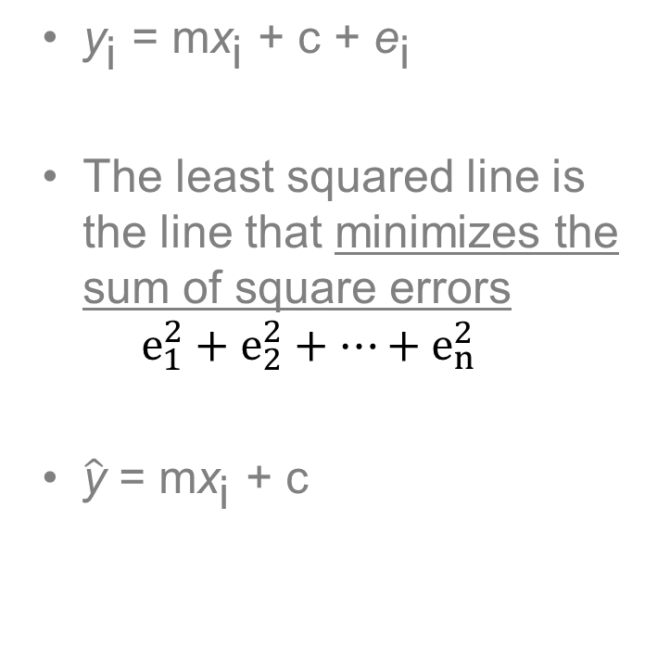

Least SSE Regression Criterion
  y
e₅
e₃
e₄
e₂
e₁
  x

Slide 7
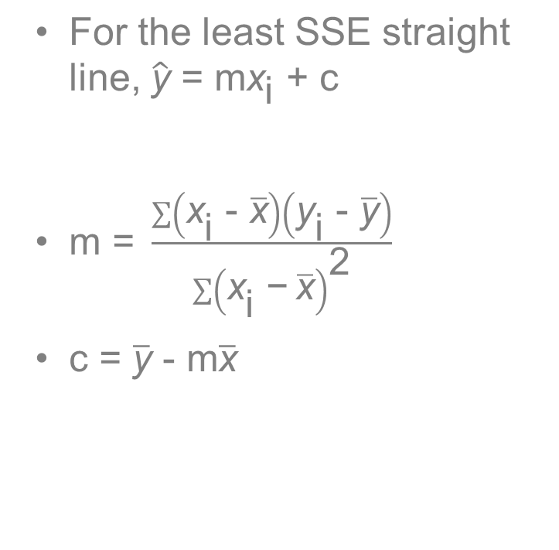
Least SSE Regression Criterion
  y
e₅
e₃
e₄
e₂
e₁
  x

Slide 8
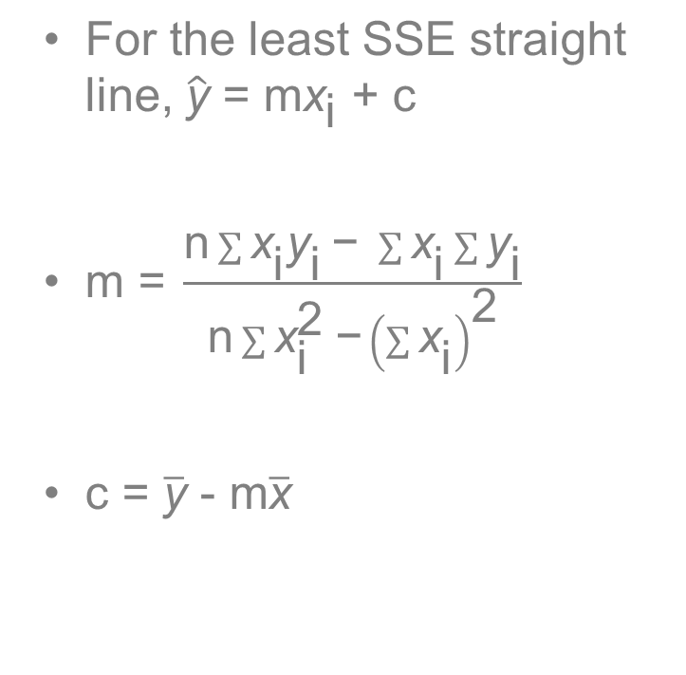
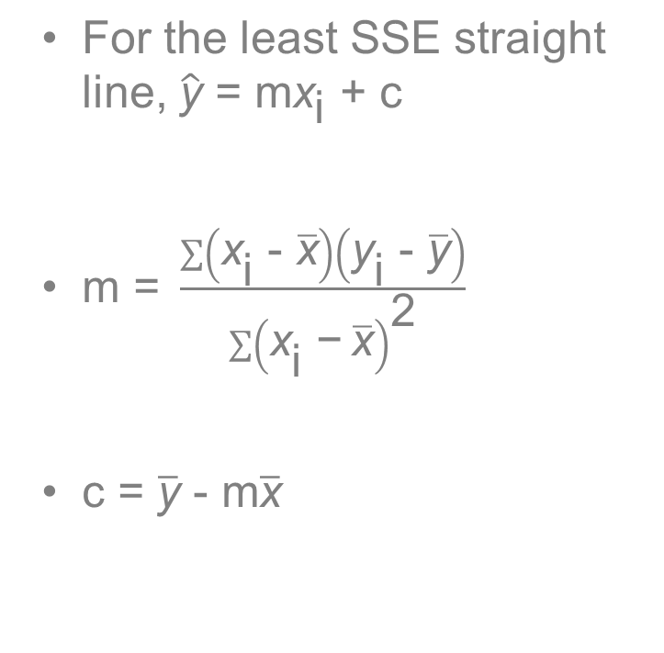
Least SSE Regression Criterion

Slide 9
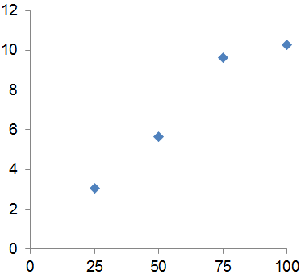
Example
  A company has been carrying out experiments with the position of a button on its website.
Page Position (% vertical) | Click Throughs (%)
25 | 3.07
50 | 5.64
75 | 9.63
100 | 10.26

Slide 10
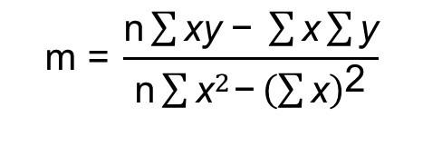
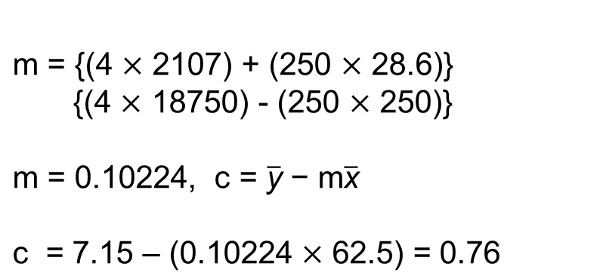
Example
  A company has been carrying out experiments with the position of a button on its website.
 | x | y | xy | x²
 | 25 | 3.07 | 76.75 | 625
 | 50 | 5.64 | 282.00 | 2500
 | 75 | 9.63 | 722.25 | 5625
 | 100 | 10.26 | 1026.00 | 10000
total | 250 | 28.6 | 2107 | 18750
mean | 62.5 | 7.15

Slide 11
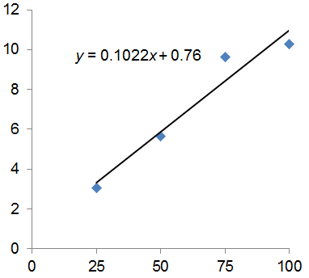
Example
  A company has been carrying out experiments with the position of a button on its website.
Page Position (% vertical) | Click Throughs (%)
25 | 3.07
50 | 5.64
75 | 9.63
100 | 10.26

Slide 12
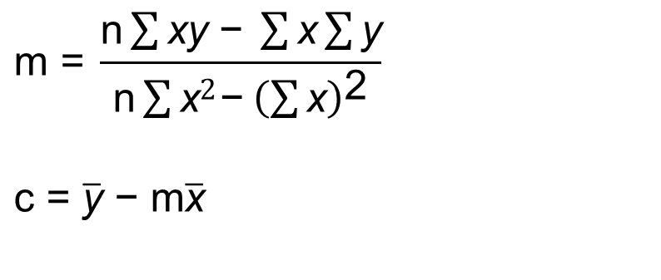
Exercise
  A company has been carrying out experiments with the position of a button on its website.
 | x | y | xy | x²
 | 25 | 1.44 |  | 5
 | 50 | 5.58 |  | 2500
 | 75 | 14.64 |  | 5625
 | 100 | 6.94 |  | 10000
total | 250 |  |  | 18750
mean | 62.5

Slide 13
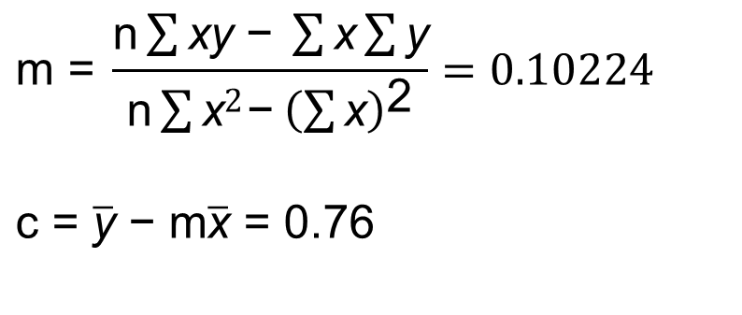
Exercise
  A company has been carrying out experiments with the position of a button on its website.
 | x | y | xy | x²
 | 25 | 1.44 | 36 | 5
 | 50 | 5.58 | 279 | 2500
 | 75 | 14.64 | 1098 | 5625
 | 100 | 6.94 | 694 | 10000
total | 250 | 28.6 | 2107 | 18750
mean | 62.5 | 7.15

Slide 14
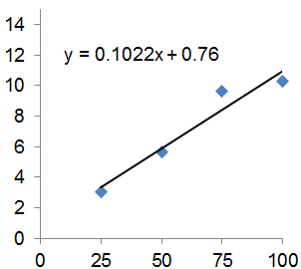
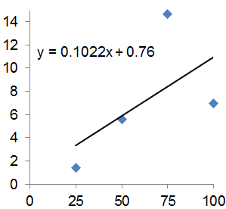
How Well Does the Line Fit?
x | y
25 | 3.07
50 | 5.64
75 | 9.63
100 | 10.26
x | y
25 | 1.44
50 | 5.58
75 | 14.64
100 | 6.94

Slide 15
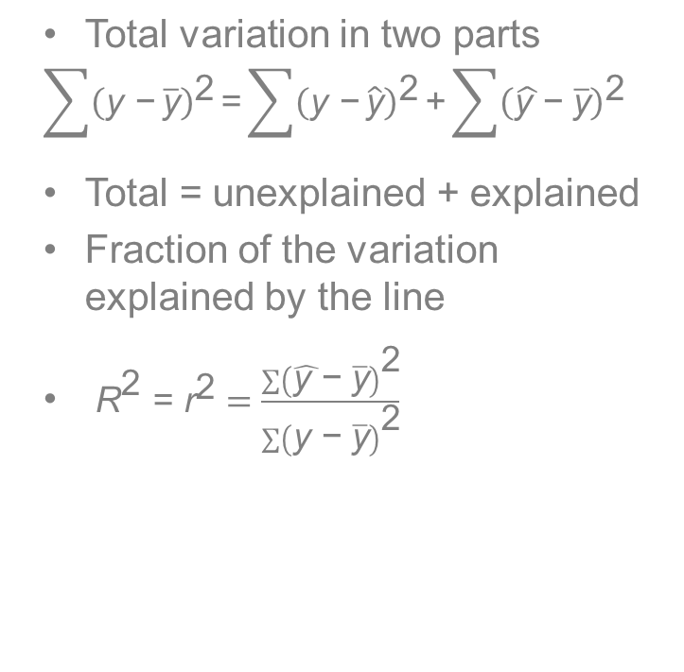
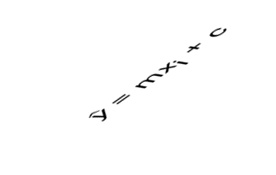


How Well Does the Line Fit?
unexplained
explained

Slide 16
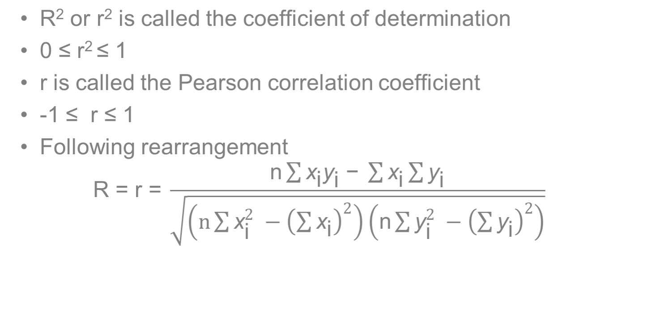
Pearson Correlation

Slide 17

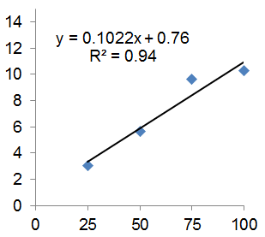
How Well Does the Line Fit?
x | y | xy | x² | y²
25 | 3.07 | 76.75 | 625
50 | 5.64 | 282.00 | 2500
75 | 9.63 | 722.25 | 5625
100 | 10.26 | 1026.00 | 10000
250 | 28.6 | 2107 | 18750
9.425
31.810
92.737
105.268
239.239

Slide 18
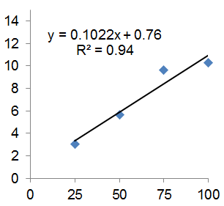
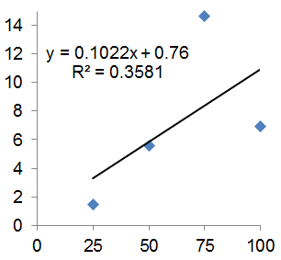
How Well Does the Line Fit?
x | y
25 | 3.07
50 | 5.64
75 | 9.63
100 | 10.26
x | y
25 | 1.44
50 | 5.58
75 | 14.64
100 | 6.94

Slide 19
Language of Correlation
  Sign
    r > 0 positive linear relationship
    r = 0 no linear relationship
    r < 0 negative linear relationship
  Strength
    Physical sciences / engineering R² > 0.6 often found
    Social sciences / policy R² > 0.25 sometimes useful
    Business and management – includes science & social science!
    But you will see language like R² > 0.8 strong, R² > 0.5 moderate, R² > 0.25 weak relationship
    Be careful; context and numbers often more informative than descriptive word, but words help to communicate.

Slide 20
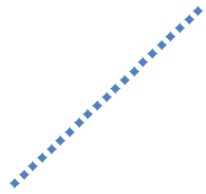





What is r?
A
B
C
r = 1
r = 0.9
r = 0.7
D
E
F
r = 0
r = -0.7
r = -0.9

Slide 21
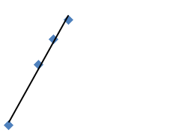
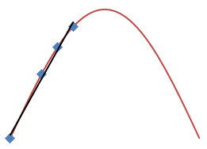
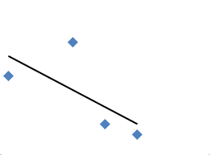
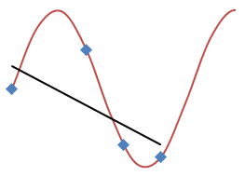
Interpolation and Extrapolation
  Interpolation - Estimates between values already known
  Extrapolation - Estimates outside known values

Slide 22
Basics of Simple Linear Regression
  Plot scatter graph to intuit whether straight line is reasonable
  Look at r² = R² for strength of relationship
  Look at sign of r for direction
    Check agrees with graph
  Look at m for gradient of relationship
  Use straight line equation to interpolate (with care)
  Use straight line equation to extrapolate (with caution)

Slide 23
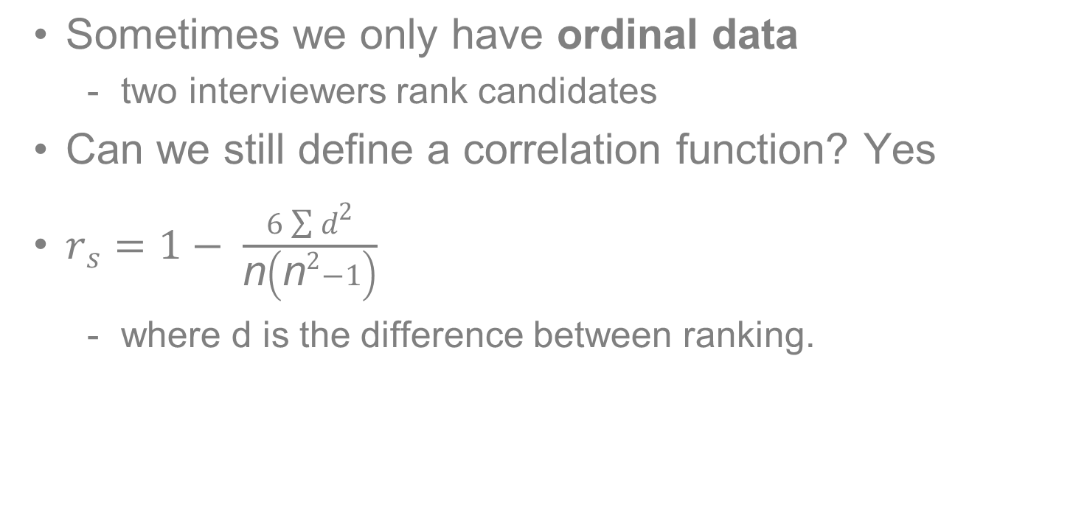
Spearman’s Rank Correlation

Slide 24
Spearman’s Correlation - Example
  Two interviewers individually rank prospective job candidates. What is the Spearman correlation coefficient?
Candidate | Interviewer 1 | Interviewer 2
Hidayat | 3 | E
Elisa | 2 | A
Nouman | 1 | B
Bernie | 4 | C
Li Ren | 5 | D
Ahere | 6 | F

Slide 25
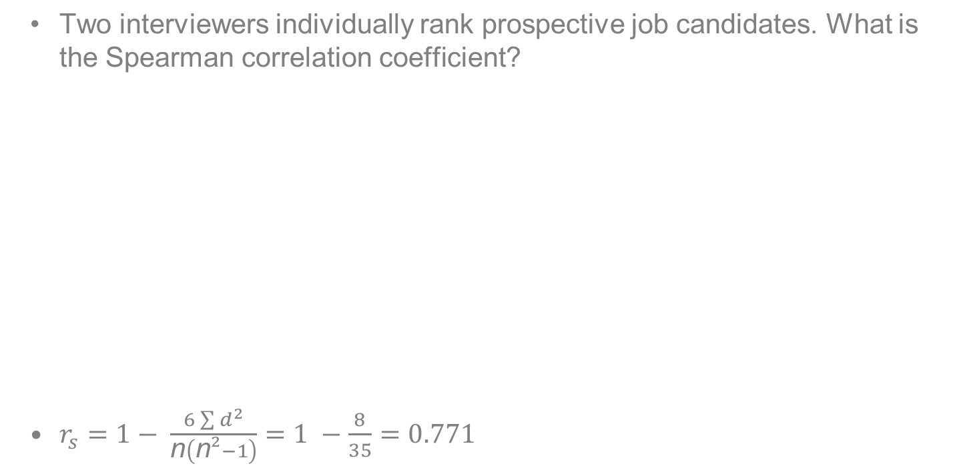
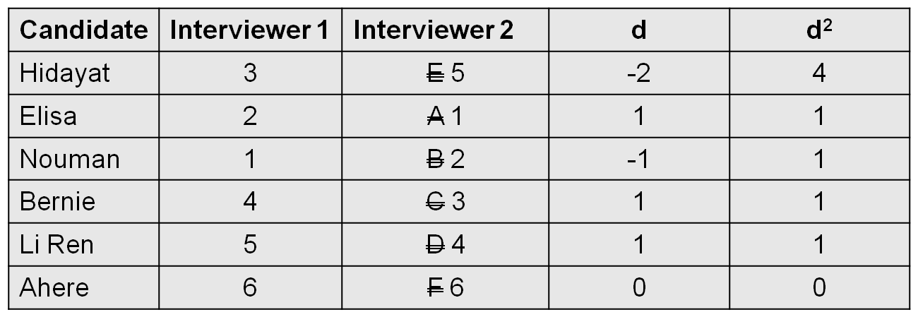
Spearman’s Correlation - Example

Slide 26
Spearman Correlation - Ties?
  For tied ranks use mean rank, then
  Use formula for Pearson correlation
Candidate | Interviewer 1 | Interviewer 2
Hidayat | 3
Elisa | 2
Nouman | 1
Bernie | 4
Li Ren | 5
Ahere | 6
4
1
2
4
4
6
OK
Excellent
Good
OK
OK
Poor

Slide 27
Recap
By the end of this topic students will be able to:
  Understand a straight line fit to bivariate data
  Calculate and interpret Pearson’s correlation coefficient
  Calculate and interpret Spearman’s correlation coefficient

Slide 28
Bibliography
  Burton, G., Carrol, G. and Wall, S. Quantitative Methods for Business and Economics. Longman.
  Buglear, J. Quantitative Methods for Business. Elsevier Butterworth Heinemann
  Hinton, PR. Statistics Explained. Routledge

Slide 29
Topic 11 – Regression Analysis
Any Questions?
Notes:
NCC Education - End Slide Master

